Slide 1
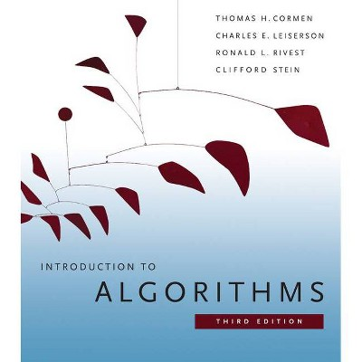
Introduction to Algorithms
Chapter 2: Getting Started

Slide 2
Getting started
We will use the insertion sort algorithm to:
    Define the pseudo code.
    Analyze its Computational/running time.
Introduce the divide-and-conquer approach to the design of algorithms and use it to develop an algorithm called merge sort.
We end with analysis of the merge sort running time.

Slide 3
Insertion Sort
If first two books are out of order
  Remove second book
  Slide first book to right
  Insert removed book into first slot
Then look at third book, if it is out of order
  Remove that book
  Slide 2nd book to right
  Insert removed book into 2nd slot
Recheck first two books again
  Etc.

Slide 4
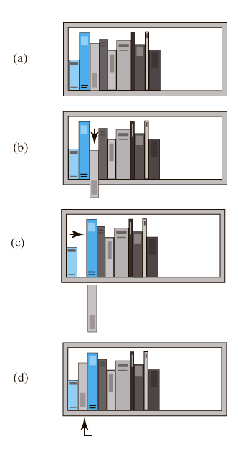
Insertion Sort
The placement of the third book during an insertion sort.

Slide 5
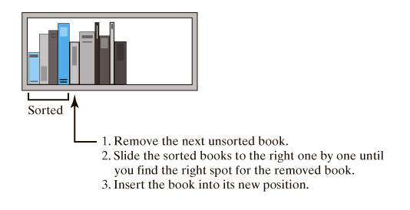
Insertion Sort
An insertion sort of books
Insertion Sort can be written iteratively or recursively

Slide 6

Example of Insertion Sort

Slide 7
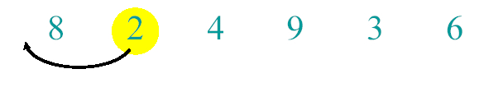
Example of Insertion Sort

Slide 8
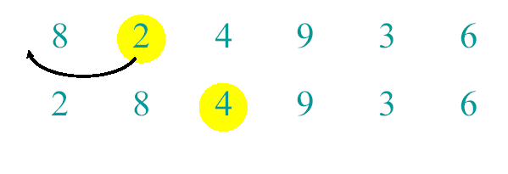
Example of Insertion Sort

Slide 9
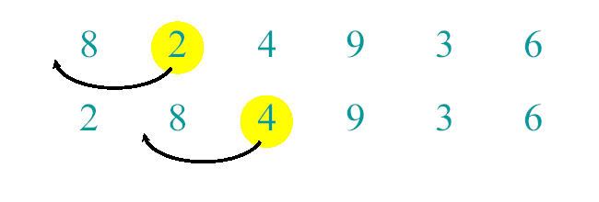
Example of Insertion Sort

Slide 10
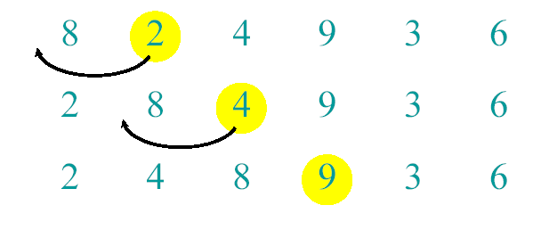
Example of Insertion Sort

Slide 11
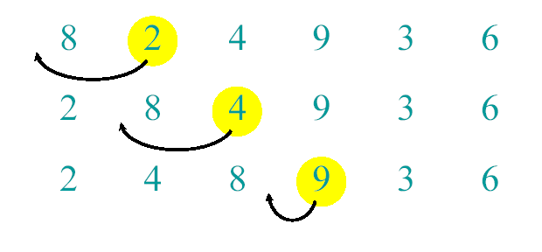
Example of Insertion Sort

Slide 12
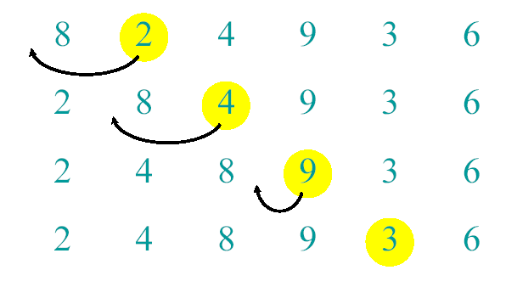
Example of Insertion Sort

Slide 13
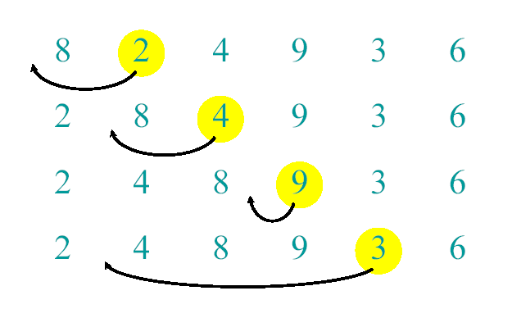
Example of Insertion Sort

Slide 14
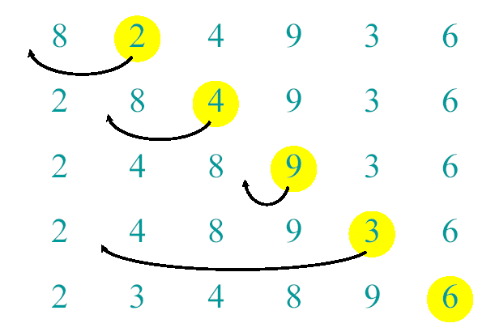
Example of Insertion Sort

Slide 15
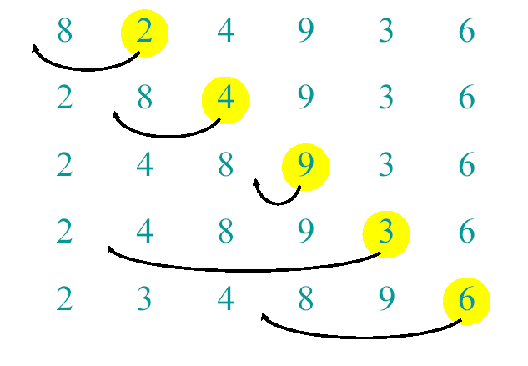
Example of Insertion Sort

Slide 16
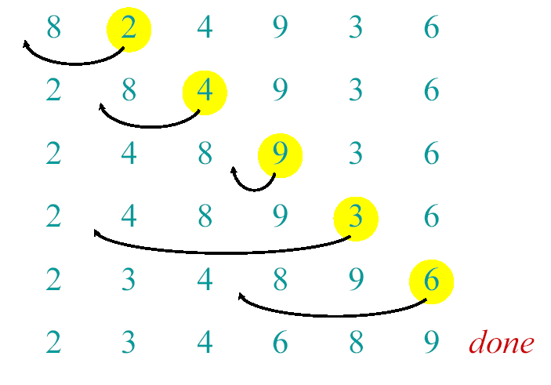
Example of Insertion Sort

Slide 17
Insertion Sort Execution Example
9
7
6
15
16
5
10
11
9
7
6
15
16
5
10
11
7
9
6
15
16
5
10
11
6
7
9
15
16
5
10
11
6
7
9
15
16
5
10
11
6
7
9
15
16
5
10
11
5
6
7
9
15
16
10
11
5
6
7
9
10
15
16
11
5
6
7
9
10
11
15
16

Slide 18
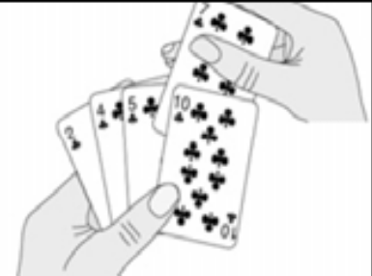
Insertion sort
Input: A sequence of n numbers {a3 , a1, a2,...,an }
Output: A reordered sequence of the input {a1 , a2, a3,...,an } such that a1≤a2 ≤a3… ≤an
Sorted array/list is by inserting one item at a
time
– Simple to implement
– Efficient on small data sets
– Efficient on already almost ordered data sets

Slide 19
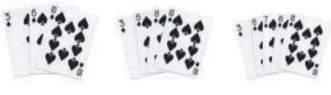
Insertion Sort
Start with a sequence of size 1
Repeatedly insert remaining elements

Slide 20
An Example: Insertion Sort
InsertionSort(A, n) {
for i = 2 to n {
key = A[i] next key
j = i - 1; go left
while (j > 0) and (A[j] > key) { find place for key
A[j+1] = A[j] shift sorted right
j = j – 1 go left
}
A[j+1] = key put key in place
}
}

Slide 21
An Example: Insertion Sort
30
10
40
20
i = ∅ j = ∅ key = ∅
A[j] = ∅ A[j+1] = ∅
1
2
3
4
InsertionSort(A, n) {
for i = 2 to n {
key = A[i]
j = i - 1;
while (j > 0) and (A[j] > key) {
A[j+1] = A[j]
j = j - 1
}
A[j+1] = key
}
}

Slide 22
An Example: Insertion Sort
30
10
40
20
i = 2 j = 1 key = 10
A[j] = 30 A[j+1] = 10
1
2
3
4
InsertionSort(A, n) {
for i = 2 to n {
key = A[i]
j = i - 1;
while (j > 0) and (A[j] > key) {
A[j+1] = A[j]
j = j - 1
}
A[j+1] = key
}
}

Slide 23
An Example: Insertion Sort
30
30
40
20
i = 2 j = 1 key = 10
A[j] = 30 A[j+1] = 30
1
2
3
4
InsertionSort(A, n) {
for i = 2 to n {
key = A[i]
j = i - 1;
while (j > 0) and (A[j] > key) {
A[j+1] = A[j]
j = j - 1
}
A[j+1] = key
}
}

Slide 24
An Example: Insertion Sort
30
30
40
20
i = 2 j = 1 key = 10
A[j] = 30 A[j+1] = 30
1
2
3
4
InsertionSort(A, n) {
for i = 2 to n {
key = A[i]
j = i - 1;
while (j > 0) and (A[j] > key) {
A[j+1] = A[j]
j = j - 1
}
A[j+1] = key
}
}

Slide 25
An Example: Insertion Sort
30
30
40
20
i = 2 j = 0 key = 10
A[j] = ∅ A[j+1] = 30
1
2
3
4
InsertionSort(A, n) {
for i = 2 to n {
key = A[i]
j = i - 1;
while (j > 0) and (A[j] > key) {
A[j+1] = A[j]
j = j - 1
}
A[j+1] = key
}
}

Slide 26
An Example: Insertion Sort
30
30
40
20
i = 2 j = 0 key = 10
A[j] = ∅ A[j+1] = 30
1
2
3
4
InsertionSort(A, n) {
for i = 2 to n {
key = A[i]
j = i - 1;
while (j > 0) and (A[j] > key) {
A[j+1] = A[j]
j = j - 1
}
A[j+1] = key
}
}

Slide 27
An Example: Insertion Sort
10
30
40
20
i = 2 j = 0 key = 10
A[j] = ∅ A[j+1] = 10
1
2
3
4
InsertionSort(A, n) {
for i = 2 to n {
key = A[i]
j = i - 1;
while (j > 0) and (A[j] > key) {
A[j+1] = A[j]
j = j - 1
}
A[j+1] = key
}
}

Slide 28
An Example: Insertion Sort
10
30
40
20
i = 3 j = 0 key = 10
A[j] = ∅ A[j+1] = 10
1
2
3
4
InsertionSort(A, n) {
for i = 2 to n {
key = A[i]
j = i - 1;
while (j > 0) and (A[j] > key) {
A[j+1] = A[j]
j = j - 1
}
A[j+1] = key
}
}

Slide 29
An Example: Insertion Sort
10
30
40
20
i = 3 j = 0 key = 40
A[j] = ∅ A[j+1] = 10
1
2
3
4
InsertionSort(A, n) {
for i = 2 to n {
key = A[i]
j = i - 1;
while (j > 0) and (A[j] > key) {
A[j+1] = A[j]
j = j - 1
}
A[j+1] = key
}
}

Slide 30
An Example: Insertion Sort
10
30
40
20
i = 3 j = 0 key = 40
A[j] = ∅ A[j+1] = 10
1
2
3
4
InsertionSort(A, n) {
for i = 2 to n {
key = A[i]
j = i - 1;
while (j > 0) and (A[j] > key) {
A[j+1] = A[j]
j = j - 1
}
A[j+1] = key
}
}

Slide 31
An Example: Insertion Sort
10
30
40
20
i = 3 j = 2 key = 40
A[j] = 30 A[j+1] = 40
1
2
3
4
InsertionSort(A, n) {
for i = 2 to n {
key = A[i]
j = i - 1;
while (j > 0) and (A[j] > key) {
A[j+1] = A[j]
j = j - 1
}
A[j+1] = key
}
}

Slide 32
An Example: Insertion Sort
10
30
40
20
i = 3 j = 2 key = 40
A[j] = 30 A[j+1] = 40
1
2
3
4
InsertionSort(A, n) {
for i = 2 to n {
key = A[i]
j = i - 1;
while (j > 0) and (A[j] > key) {
A[j+1] = A[j]
j = j - 1
}
A[j+1] = key
}
}

Slide 33
An Example: Insertion Sort
10
30
40
20
i = 3 j = 2 key = 40
A[j] = 30 A[j+1] = 40
1
2
3
4
InsertionSort(A, n) {
for i = 2 to n {
key = A[i]
j = i - 1;
while (j > 0) and (A[j] > key) {
A[j+1] = A[j]
j = j - 1
}
A[j+1] = key
}
}

Slide 34
An Example: Insertion Sort
10
30
40
20
i = 4 j = 2 key = 40
A[j] = 30 A[j+1] = 40
1
2
3
4
InsertionSort(A, n) {
for i = 2 to n {
key = A[i]
j = i - 1;
while (j > 0) and (A[j] > key) {
A[j+1] = A[j]
j = j - 1
}
A[j+1] = key
}
}

Slide 35
An Example: Insertion Sort
10
30
40
20
i = 4 j = 2 key = 20
A[j] = 30 A[j+1] = 40
1
2
3
4
InsertionSort(A, n) {
for i = 2 to n {
key = A[i]
j = i - 1;
while (j > 0) and (A[j] > key) {
A[j+1] = A[j]
j = j - 1
}
A[j+1] = key
}
}

Slide 36
An Example: Insertion Sort
10
30
40
20
i = 4 j = 2 key = 20
A[j] = 30 A[j+1] = 40
1
2
3
4
InsertionSort(A, n) {
for i = 2 to n {
key = A[i]
j = i - 1;
while (j > 0) and (A[j] > key) {
A[j+1] = A[j]
j = j - 1
}
A[j+1] = key
}
}

Slide 37
An Example: Insertion Sort
10
30
40
20
i = 4 j = 3 key = 20
A[j] = 40 A[j+1] = 20
1
2
3
4
InsertionSort(A, n) {
for i = 2 to n {
key = A[i]
j = i - 1;
while (j > 0) and (A[j] > key) {
A[j+1] = A[j]
j = j - 1
}
A[j+1] = key
}
}

Slide 38
An Example: Insertion Sort
10
30
40
20
i = 4 j = 3 key = 20
A[j] = 40 A[j+1] = 20
1
2
3
4
InsertionSort(A, n) {
for i = 2 to n {
key = A[i]
j = i - 1;
while (j > 0) and (A[j] > key) {
A[j+1] = A[j]
j = j - 1
}
A[j+1] = key
}
}

Slide 39
An Example: Insertion Sort
10
30
40
40
i = 4 j = 3 key = 20
A[j] = 40 A[j+1] = 40
1
2
3
4
InsertionSort(A, n) {
for i = 2 to n {
key = A[i]
j = i - 1;
while (j > 0) and (A[j] > key) {
A[j+1] = A[j]
j = j - 1
}
A[j+1] = key
}
}

Slide 40
An Example: Insertion Sort
10
30
40
40
i = 4 j = 3 key = 20
A[j] = 40 A[j+1] = 40
1
2
3
4
InsertionSort(A, n) {
for i = 2 to n {
key = A[i]
j = i - 1;
while (j > 0) and (A[j] > key) {
A[j+1] = A[j]
j = j - 1
}
A[j+1] = key
}
}

Slide 41
An Example: Insertion Sort
10
30
40
40
i = 4 j = 3 key = 20
A[j] = 40 A[j+1] = 40
1
2
3
4
InsertionSort(A, n) {
for i = 2 to n {
key = A[i]
j = i - 1;
while (j > 0) and (A[j] > key) {
A[j+1] = A[j]
j = j - 1
}
A[j+1] = key
}
}

Slide 42
An Example: Insertion Sort
10
30
40
40
i = 4 j = 2 key = 20
A[j] = 30 A[j+1] = 40
1
2
3
4
InsertionSort(A, n) {
for i = 2 to n {
key = A[i]
j = i - 1;
while (j > 0) and (A[j] > key) {
A[j+1] = A[j]
j = j - 1
}
A[j+1] = key
}
}

Slide 43
An Example: Insertion Sort
10
30
40
40
i = 4 j = 2 key = 20
A[j] = 30 A[j+1] = 40
1
2
3
4
InsertionSort(A, n) {
for i = 2 to n {
key = A[i]
j = i - 1;
while (j > 0) and (A[j] > key) {
A[j+1] = A[j]
j = j - 1
}
A[j+1] = key
}
}

Slide 44
An Example: Insertion Sort
10
30
30
40
i = 4 j = 2 key = 20
A[j] = 30 A[j+1] = 30
1
2
3
4
InsertionSort(A, n) {
for i = 2 to n {
key = A[i]
j = i - 1;
while (j > 0) and (A[j] > key) {
A[j+1] = A[j]
j = j - 1
}
A[j+1] = key
}
}

Slide 45
An Example: Insertion Sort
10
30
30
40
i = 4 j = 2 key = 20
A[j] = 30 A[j+1] = 30
1
2
3
4
InsertionSort(A, n) {
for i = 2 to n {
key = A[i]
j = i - 1;
while (j > 0) and (A[j] > key) {
A[j+1] = A[j]
j = j - 1
}
A[j+1] = key
}
}

Slide 46
An Example: Insertion Sort
10
30
30
40
i = 4 j = 1 key = 20
A[j] = 10 A[j+1] = 30
1
2
3
4
InsertionSort(A, n) {
for i = 2 to n {
key = A[i]
j = i - 1;
while (j > 0) and (A[j] > key) {
A[j+1] = A[j]
j = j - 1
}
A[j+1] = key
}
}

Slide 47
An Example: Insertion Sort
10
30
30
40
i = 4 j = 1 key = 20
A[j] = 10 A[j+1] = 30
1
2
3
4
InsertionSort(A, n) {
for i = 2 to n {
key = A[i]
j = i - 1;
while (j > 0) and (A[j] > key) {
A[j+1] = A[j]
j = j - 1
}
A[j+1] = key
}
}

Slide 48
An Example: Insertion Sort
10
20
30
40
i = 4 j = 1 key = 20
A[j] = 10 A[j+1] = 20
1
2
3
4
InsertionSort(A, n) {
for i = 2 to n {
key = A[i]
j = i - 1;
while (j > 0) and (A[j] > key) {
A[j+1] = A[j]
j = j - 1
}
A[j+1] = key
}
}

Slide 49
An Example: Insertion Sort
10
20
30
40
i = 4 j = 1 key = 20
A[j] = 10 A[j+1] = 20
1
2
3
4
InsertionSort(A, n) {
for i = 2 to n {
key = A[i]
j = i - 1;
while (j > 0) and (A[j] > key) {
A[j+1] = A[j]
j = j - 1
}
A[j+1] = key
}
}
Done!

Slide 50
Insertion Sort
InsertionSort(A, n) {
for i = 2 to n {
key = A[i]
j = i - 1;
while (j > 0) and (A[j] > key) {
A[j+1] = A[j]
j = j - 1
}
A[j+1] = key
}
}
How many times will
this while loop execute?

Slide 51
Insertion Sort
This algorithm takes as parameter an array of the sequence numbers to be sorted A[1 … n], .
When this algorithm finish, the input array will contains the sorted sequence numbers (sort in place: the sorted items (output) occupy the same storage as the original ones (input) ).

Slide 52
Loop invariants and correctness of insertion sort
Claim: at the start of each iteration of the for loop, the subarray A[1..j-1] consists of the elements originally in A[1..j-1] but in sorted order.
Proof: by induction

Slide 53
Review: Proof By Induction
Claim:S(n) is true for all n >= 1
Basis:
  Show formula is true when n = 1
Inductive hypothesis:
  Assume formula is true for an arbitrary n = k
Step:
  Show that formula is then true for n = k+1

Slide 54
Prove correctness using loop invariants
Initialization (basis): the loop invariant is true prior to the first iteration of the loop
Maintenance:
  Assume that it is true before an iteration of the loop (Inductive hypothesis)
  Show that it remains true before the next iteration (Step)
Termination: show that when the loop terminates, the loop invariant gives us a useful property to show that the algorithm is correct

Slide 55
Prove correctness using loop invariants
InsertionSort(A, n) {
for j = 2 to n {
key = A[j];
i = j - 1;
▷Insert A[j] into the sorted sequence A[1..j-1]
while (i > 0) and (A[i] > key) {
A[i+1] = A[i];
i = i – 1;
}
A[i+1] = key
}
}
Loop invariant: at the start of each iteration of the for loop, the subarray A[1..j-1] consists of the elements originally in A[1..j-1] but in sorted order.

Slide 56
Initialization
InsertionSort(A, n) {
for j = 2 to n {
key = A[j];
i = j - 1;
▷Insert A[j] into the sorted sequence A[1..j-1]
while (i > 0) and (A[i] > key) {
A[i+1] = A[i];
i = i – 1;
}
A[i+1] = key
}
}
Subarray A[1] is sorted. So loop invariant is true before the loop starts.

Slide 57
Maintenance
InsertionSort(A, n) {
for j = 2 to n {
key = A[j];
i = j - 1;
▷Insert A[j] into the sorted sequence A[1..j-1]
while (i > 0) and (A[i] > key) {
A[i+1] = A[i];
i = i – 1;
}
A[i+1] = key
}
}
Assume loop variant is true prior to iteration j
Loop variant will be true before iteration j+1
1
i
j
sorted
Key

Slide 58
Termination
InsertionSort(A, n) {
for j = 2 to n {
key = A[j];
i = j - 1;
▷Insert A[j] into the sorted sequence A[1..j-1]
while (i > 0) and (A[i] > key) {
A[i+1] = A[i];
i = i – 1;
}
A[i+1] = key
}
}
The algorithm is correct!
Upon termination, A[1..n] contains all the original elements of A in sorted order.
1
n
j=n+1
Sorted

Slide 59
Kinds of analyses
Worst-case: (usually)
  T(n) = maximum time of algorithm on any input of size n.
Average-case: (sometimes)
  T(n) = expected time of algorithm over all inputs of size n.
  Need assumption of statistical distribution of inputs.
Best-case: (NEVER)
  Cheat with a slow algorithm that works fast on some input.

Slide 60
Analyzing algorithms
We need to predict the resources ( memory, communication bandwidth, or computer hardware) that the algorithm requires.
Most often it is computational time that we want to measure.
By analyzing several candidate algorithms for a problem, the most efficient one can be easily identified.
Unless other thing specified, we shall assume that our algorithms will be implemented on a generic one processor computer with the instructions being executed one after another, with no concurrent operations.

Slide 61
Analysis of insertion sort
The time taken by insertion sort depends on the input (sorting thousand items takes more time than sorting three items).
In general, the time taken by an algorithm grows with the size of the input, so it is traditional to describe the running time of a program as a function of the size of its input.
Input size depends on the problem being studied
( Ex: sort algorithm: the number of items to be sorted. Multiplying two integers: the total number of bits needed to represent the input in ordinary binary notation.
In graphs: the input size can be described by the numbers of vertices and edges in the graph).

Slide 62
Analysis of insertion sort
The running time of an algorithm on a particular input is the number of primitive operations or "steps" executed.
A constant amount of time is required to execute each line of our pseudo-code. One line may take a different amount of time than another line, but we shall assume that each execution of the i^{th} line takes time c_{i} , where c_{i} is a constant.
We start by presenting the INSERTION-SORT procedure with the time "cost" of each statement and the number of times each statement is executed.

Slide 63
Analysis of insertion sort
For each i = 2, 3, . . . , n, where n = length[A], we let j be the number of times the while loop test is executed for that value of i. When a for or while loop exits in the usual way (i.e., due to the test in the loop header), the test is executed one time more than the loop body.
We assume that comments are not executable statements, and so they take no time.
The running time of the algorithm is the sum of running times for each statement executed; a statement that takes c_{i} steps to execute and is executed n times will contribute c_{i} n to the total running time.

Slide 64
Insertion Sort
Statement Effort
InsertionSort(A, n) {
for i = 2 to n { c₁n
key = A[i] c₂(n-1)
j = i - 1 c₃(n-1)
while (j > 0) and (A[j] > key) { c₄C
A[j+1] = A[j] c₅(C-(n-1))
j = j – 1} c₆(C-(n-1))
A[j+1] = key c₇(n-1)
}}
C = t₂ + t₃ + … + t_{n} where t_{i} is number of while expression evaluations for the i^{th} for loop iteration
Body of the while statement is executed= (t₂ - 1) + (t₃ – 1) + … + (t_{n} – 1)
= t₂ + t₃ + … + t_{n} – (n-1) = C – (n-1)

Slide 65
Analyzing Insertion Sort
T(n) = c₁n + c₂(n-1) + c₃(n-1) + c₄C + c₅(C - (n-1)) + c₆(C - (n-1)) + c₇(n-1)
= c₈C + c₉n + c₁₀
What can C be?
  Best case -- inner loop body never executed (array is sorted)
    t_{i} = 1 ➔ T(n) is a linear function = a.n + b
  Worst case -- inner loop body executed for all previous elements (array sorted in reverse order)
    t_{i} = i ➔ T(n) is a quadratic function = a.n² + b.n + c
  If T is a quadratic function, which terms in the above equation matter?
c₁n
c₂(n-1)
c₃(n-1)
c₄C
c₅(C-(n-1))
c₆(C-(n-1))
c₇(n-1)

Slide 66
Analyzing Insertion Sort (Cont.)
Best Case
  If A is sorted: O(n) comparisons
    linear function of n
Worst Case
  If A is reversed sorted: O(n²) comparisons
    quadratic function of n
Average Case
  If A is randomly sorted: O(n²) comparisons

Slide 67
Worst-case and average-case analysis
The worst-case running time of an algorithm is an upper bound on the running time for any input.
  Knowing it gives us a guarantee that the algorithm will never take any longer.
The "average case" is often roughly as bad as the worst case.
  Suppose that we randomly choose n numbers and apply insertion sort. How long does it take to determine where in sub-array A[1… i -1]to insert element A[i], On average, half the elements in A[1…i - 1] are less than A[i], and half the elements are greater.

Slide 68
Insertion sort – Order of growth
This worst-case running time can be expressed as an ² + bn + c for constants a, b, and c
To find the order of growth we consider only the leading term of a formula (e.g, an² ), since the lower-order terms are relatively insignificant for large n.
We also ignore the leading term's constant coefficient, since constant factors are less significant than the rate of growth in determining computational efficiency for large inputs.

Slide 69
Insertion sort – Order of growth
We usually consider one algorithm to be more efficient than another if its worst-case running time has a lower order of growth.
Due to constant factors and lower-order terms, this evaluation may be in error for small inputs. But not for large enough inputs

